Slide 1
Chapter 1
OPERATING SYSTEM

Slide 2
What is Operating System?
A program that controls the execution of application programs
An interface between applications and hardware
Objectives of OS:-
Convenience
Efficiency
Ability to evolve

Slide 3
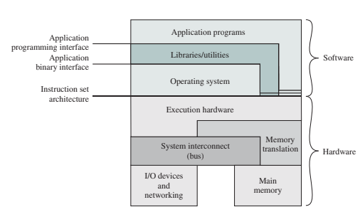
Three Aspects of Operating System
OS as a User/Computer Interface:

Slide 4
Three Aspects of Operating System
OS as a User/ Computer Interface:-
OS provides services in the following areas:
Program Development
Program Execution
Access to I/O devices
Controlled access to files
System Access
Error detection and response
Accounting

Slide 5
Three Aspects of Operating System
OS as a Resource Manager:-
OS is responsible for managing various Resources.
To manage resources, OS is in control of computer’s basic functions.
Control mechanism is in 2 ways
a) OS is itself a set of programs, executed by processor b) OS frequently gives control to processor to allow it to regain back.

Slide 6
Three Aspects of Operating System
OS as a Resource Manager:-
CONTROL OF OS
1)OS provides instruction to Processor
2) OS directs to use of resources and timings
CONTROL OF PROCESSOR
3) Processor cease the execution of OS and execute other programs .
4) Thus OS gives the control to Processor and it again resumes back to prepare processor to do next piece of work.
Thus control is in both side OS as well as CPU

Slide 7
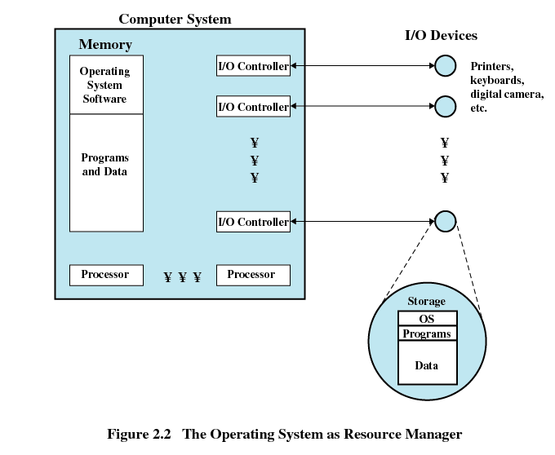

Slide 8
Three Aspects of Operating System
Ease of evolution of an OS:
1) Hardware upgrades plus new type of hardware.
2) New services
3) Fixes

Slide 9
Evolution of Operating System
OS have evolved over the years in 4 ways:-
Serial processing.
Simple Batch System.
Multi-programmed batch system.
Time sharing system.

Slide 10
Evolution of Operating System
Serial processing-
  No operating system
  Machines run from a console with display lights, toggle switches, input device, and printer
  There are 2 key problems:-
  Schedule time-
  Allotted time for users
  Setup time-
  Included loading the compiler, source program, saving compiled program, and loading and linking

Slide 11
Evolution of Operating System
Simple batch systems-
  Central idea for this – is the use of a piece of software known as the Monitor
  Computer operator –
  Accepts the job on the card submitted by the user
  Batches the jobs together and places them on input device for the use of monitor.
  Monitor does the following things-
  Loads the job from the input device.
  When job execution is over ,control is transferred to monitor.
  Monitor automatically loads next job in memory.

Slide 12
Evolution of Operating System
Interrupt Processing
Device drivers
Job sequencing
Control language Interpreter
User program and data
Simple batch systems-
  Memory layout of Resident Monitor
  Improves Job set up time.
  Instructions are provided to monitor in the
  program using Job Control Language.

Slide 13
Evolution of Operating System
Simple batch system-
Ex: Fortran program plus data and JCL
$JOB
$FTN
.
.
$LOAD
$RUN
.
.
$END
Fortran instructions
Data

Slide 14
Evolution of Operating System
Simple batch systems-
With monitor , other hardware features are also required
1) Memory Protection
2) Timer
3) Privileged instructions
4) Interrupts

Slide 15
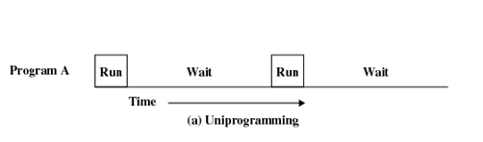
Evolution of Operating System
Multi-programmed batch systems-
In Simple batch system, a job needs any I/O operation, it requests monitor to perform for it.
Till that processor is idle as I/O devices are slower.
This is case when single program is present in the memory called as Uni-programming.

Slide 16
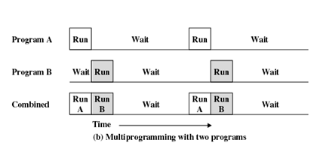
Evolution of Operating System
Multi-programmed batch systems-
This is inefficient, as memory is available suppose to hold 2 more programs plus monitor.
When one job needs to wait for I/O, the processor can switch to the other job. This approach is called multiprogramming or multitasking.

Slide 17
Evolution of Operating System
Time sharing Systems-
It is a logical extension of multiprogramming.
Jobs of different users are switched by CPU.
CPU executes multiple jobs by switching among them.
Rapid switching of job by CPU ,creates impression that entire computer system is dedicated to one user only.
Useful for interactive jobs.
ex: The output is to a display for the user.
Input is from the user keyboard.

Slide 18
Evolution of Operating System
Time sharing Systems-
The time is sliced at regular time intervals, this time interval is called as time slicing.
Ex:
Job1-24ms
Job2-3ms
Job3 -3ms
Time slice is 4ms
Then
0 4 7 10 14 18 22 26 30
J1 | J2 | J3 | J1 | J1 | J1 | J1 | J1

Slide 19
Basic Concepts
Process:
Process is basically program in execution.
It consists of :
  1) Executable code
  2) Program’s data
  3) Program’s stack
  4) Program counter
  5) List of files
  6) Other registers
  Each process is characterized by information stored in Process Control Block (PCB)

Slide 20
Basic Concepts
Files:
File is collection of data .
Way of grouping of files is called as directory
Top directory in directory hierarchy is called as root directory.
Every file within directory hierarchy can be specified by giving its Pathname
Pathname can be absolute or relative.

Slide 21
Basic Concepts
System Calls:
User programs communicate with operating system and request services from OS by making System Calls.
Corresponding to each system call there is a library procedure that user programs can call.
Ex:
Read one file and to copy them to another file.

Slide 22
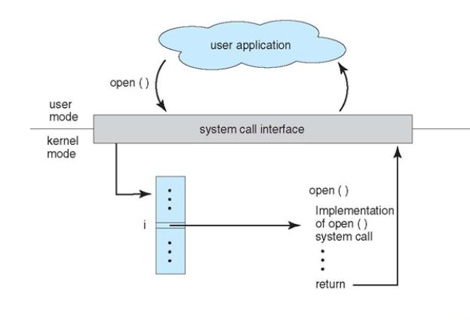
Basic Concepts
System Calls Diagram:

Slide 23
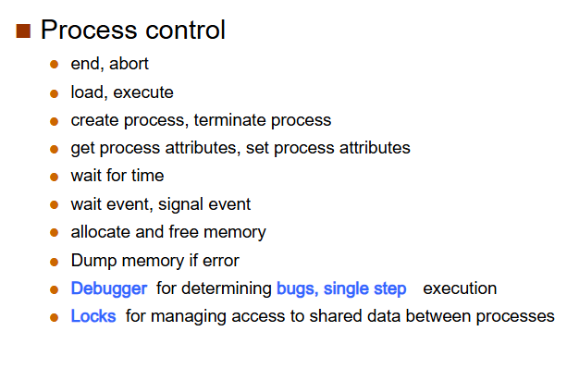
Basic Concepts
Various types of System Calls:

Slide 24
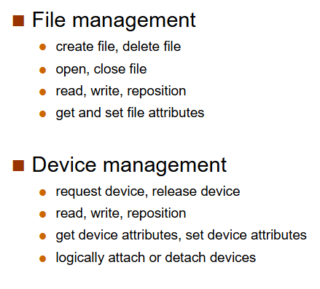
Basic Concepts Contd..
Various types of System Calls contd..:

Slide 25
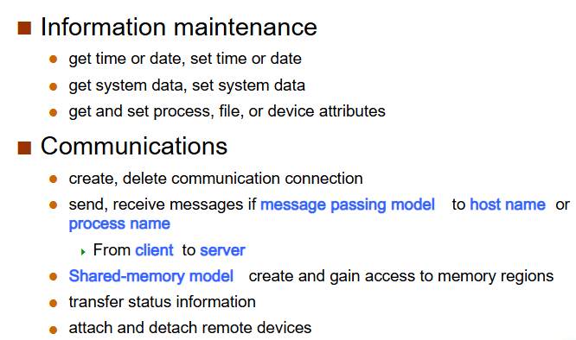
Basic Concepts Contd..
Various types of System Calls contd..:

Slide 26
Basic Concepts
Shell
It is a command interpreter.
Accepts commands through shell prompt:
Ex:
$ sort <file1.txt > file2.txt
$ cat file1.txt file2.txt >file3.txt
Std . Input Redirection
Std . output Redirection

Slide 27
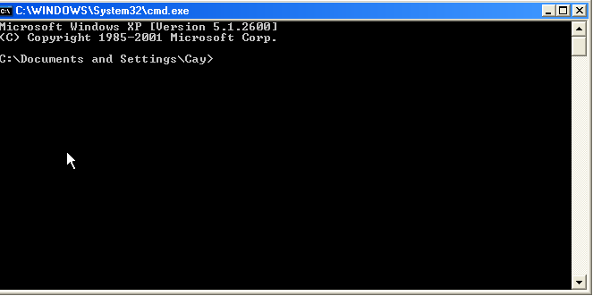
Basic Concepts
Shell-
DOS shell- Command shell.
A command shell is simply a window without any graphical decorations .

Slide 28
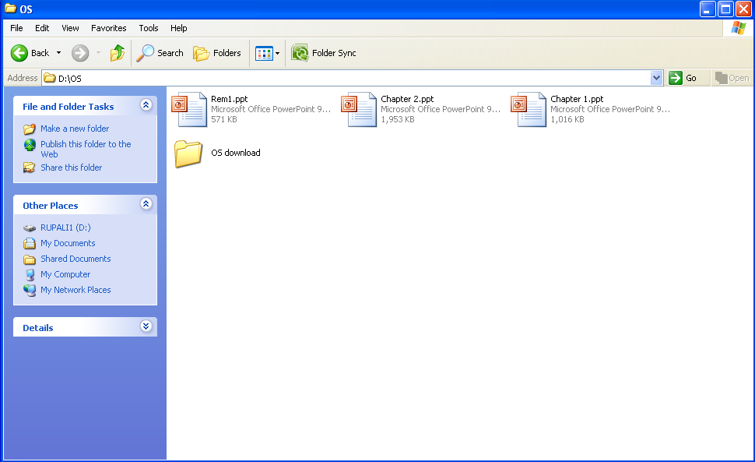
Basic Concepts
Shell-
Windows shell is the main graphical user interface in Microsoft Windows.
WIMP interface(Windows ,Icons, Menu, Pointer)

Slide 29
Basic Concepts
Operating System structure:
This suggests the structuring of OS into relatively independent parts that provides simple individual features, thus keeping complexity of the design manageable.
This shows how the OS is internally.
There are 3 types of OS structure:
1) Monolithic Structure
2) Microkernel Structure
3) Layered Structure
4) Virtualized Systems

Slide 30
Basic Concepts
Operating System structure:
Monolithic structure:
1) No specific structure.
2) OS is a collection of procedures and subprocedures.
3) OS provides system calls.
4) Special trap instruction known as Kernel Call or Supervisor call.

Slide 31
Basic Concepts
Operating System structure:
Monolithic structure:
User program n
User program 1
Index
table
Service procedure

Slide 32
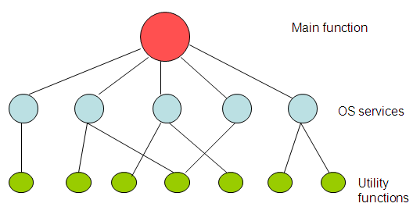
Basic Concepts
Operating System structure:
Monolithic structure with respect to procedures:

Slide 33
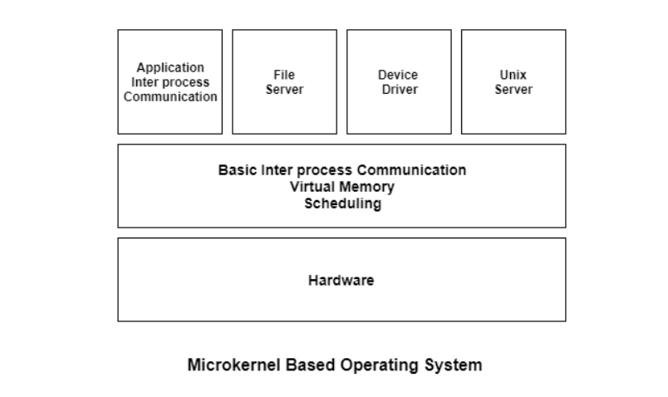
Basic Concepts
Operating System structure:
Microkernel OS structure:
A microkernel is the minimum software that is required to correctly implement an operating system.
This includes memory, process scheduling mechanisms and basic inter-process communication.

Slide 34
Basic Concepts
Operating System structure:
Microkernel OS structure:
A microkernel contains only the core functionalities of the system.
A component is included in the microkernel only if putting it outside would disrupt the functionality of the system.
All the other non-essential components are put in the user mode.
The minimum functionalities included in the microkernel are −
1. Memory management mechanisms like address spaces are included in the microkernel. This also contains memory protection features.
2. Processor scheduling mechanisms are also necessary in the microkernel. This contains process and thread schedulers.
3. Interprocess communication is important as it is needed to manage the servers that run their own address spaces.

Slide 35
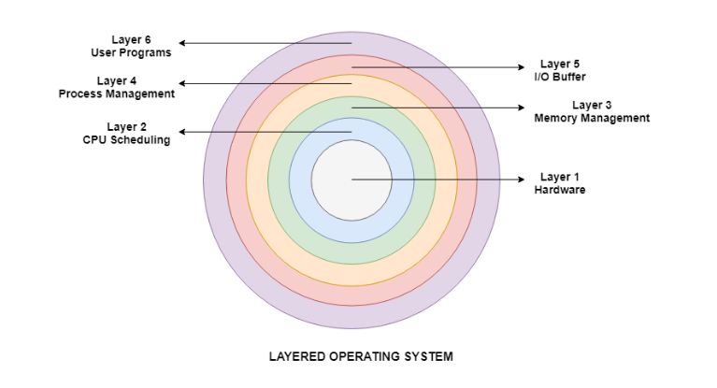
Basic Concepts
Operating System structure:
Layered structure:
1) This OS structure has 6 layers:

Slide 36
Basic Concepts
Hardware
This layer interacts with the system hardware and coordinates with all the peripheral devices used such as printer, mouse, keyboard, scanner etc. The hardware layer is the lowest layer in the layered operating system architecture.
CPU scheduling
This layer deals with scheduling the processes for the CPU. There are many scheduling queues that are used to handle processes. When the processes enter the system, they are put into the job queue. The processes that are ready to execute in the main memory are kept in the ready queue.
Memory Management
Memory management deals with memory and the moving of processes from disk to primary memory for execution and back again. This is handled by the third layer of the operating system.

Slide 37
Basic Concepts
Process Management
This layer is responsible for managing the processes i.e assigning the processor to a process at a time. This is known as process scheduling. The different algorithms used for process scheduling are FCFS (first come first served), SJF (shortest job first), priority scheduling, round-robin scheduling etc.
I/O Buffer
I/O devices are very important in the computer systems. They provide users with the means of interacting with the system. This layer handles the buffers for the I/O devices and makes sure that they work correctly.
User Programs
This is the highest layer in the layered operating system. This layer deals with the many user programs and applications that run in an operating system such as word processors, games, browsers etc.

Slide 38
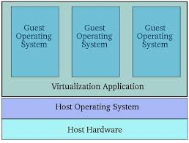
Basic Concepts
Operating System structure:
Virtualized systems:
1. It refers to running multiple operating systems on a computer system simultaneously.
2.For virtualization, technology used is Hypervisors(2 types Hosted and bare metal).

Slide 39
What is virtualization
In computing, virtualization is the act of creating a virtual (rather than actual) version of something, including virtual computer hardware platforms, storage devices, and computer network resources.
Virtualization describes a technology in which an application, guest operating system (guest OS) or data storage is abstracted away from the true underlying hardware or software
Using Hypervisor, Hypervisors take the physical resources and separate them so they can be utilized by the virtual environment.
Using this virtual environment guest OS get installed on the top of the host OS ( called as hosted hypervisor) or they can be directly installed onto the hardware(called as bare metal hypervisor-XEN server)

